Slide 1

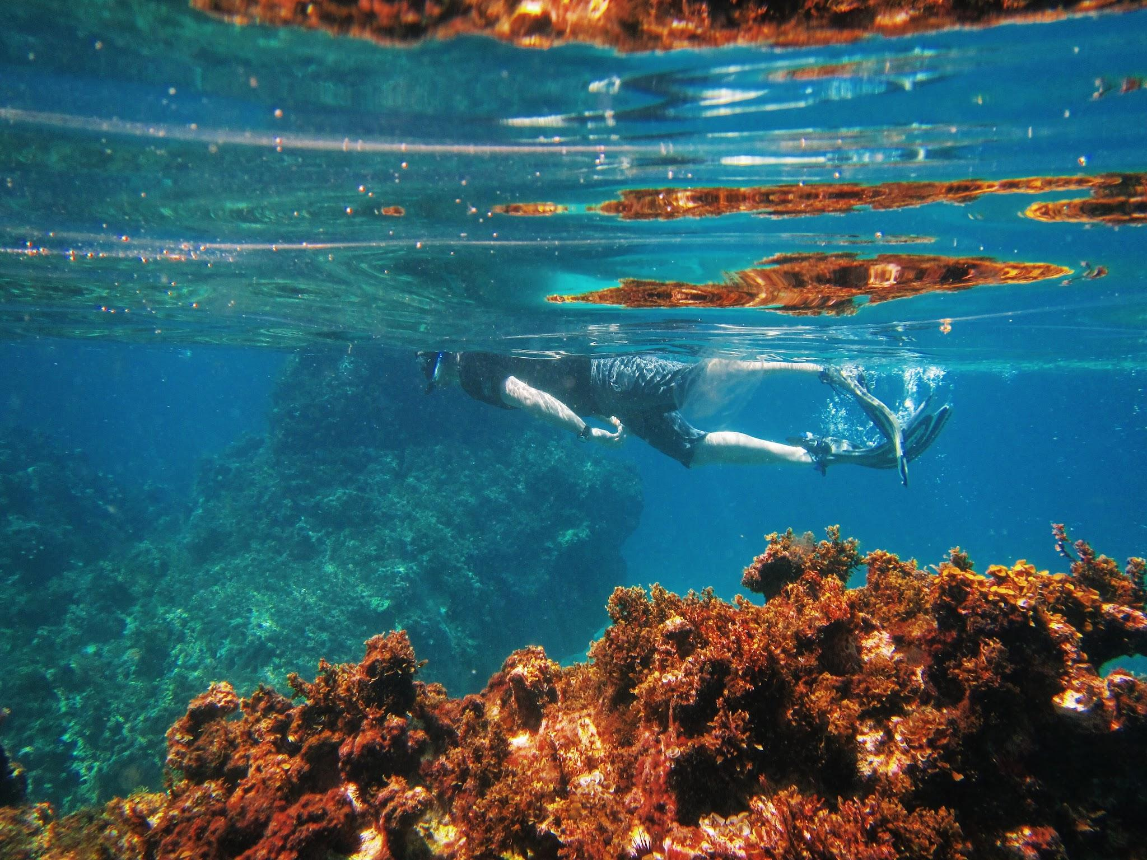

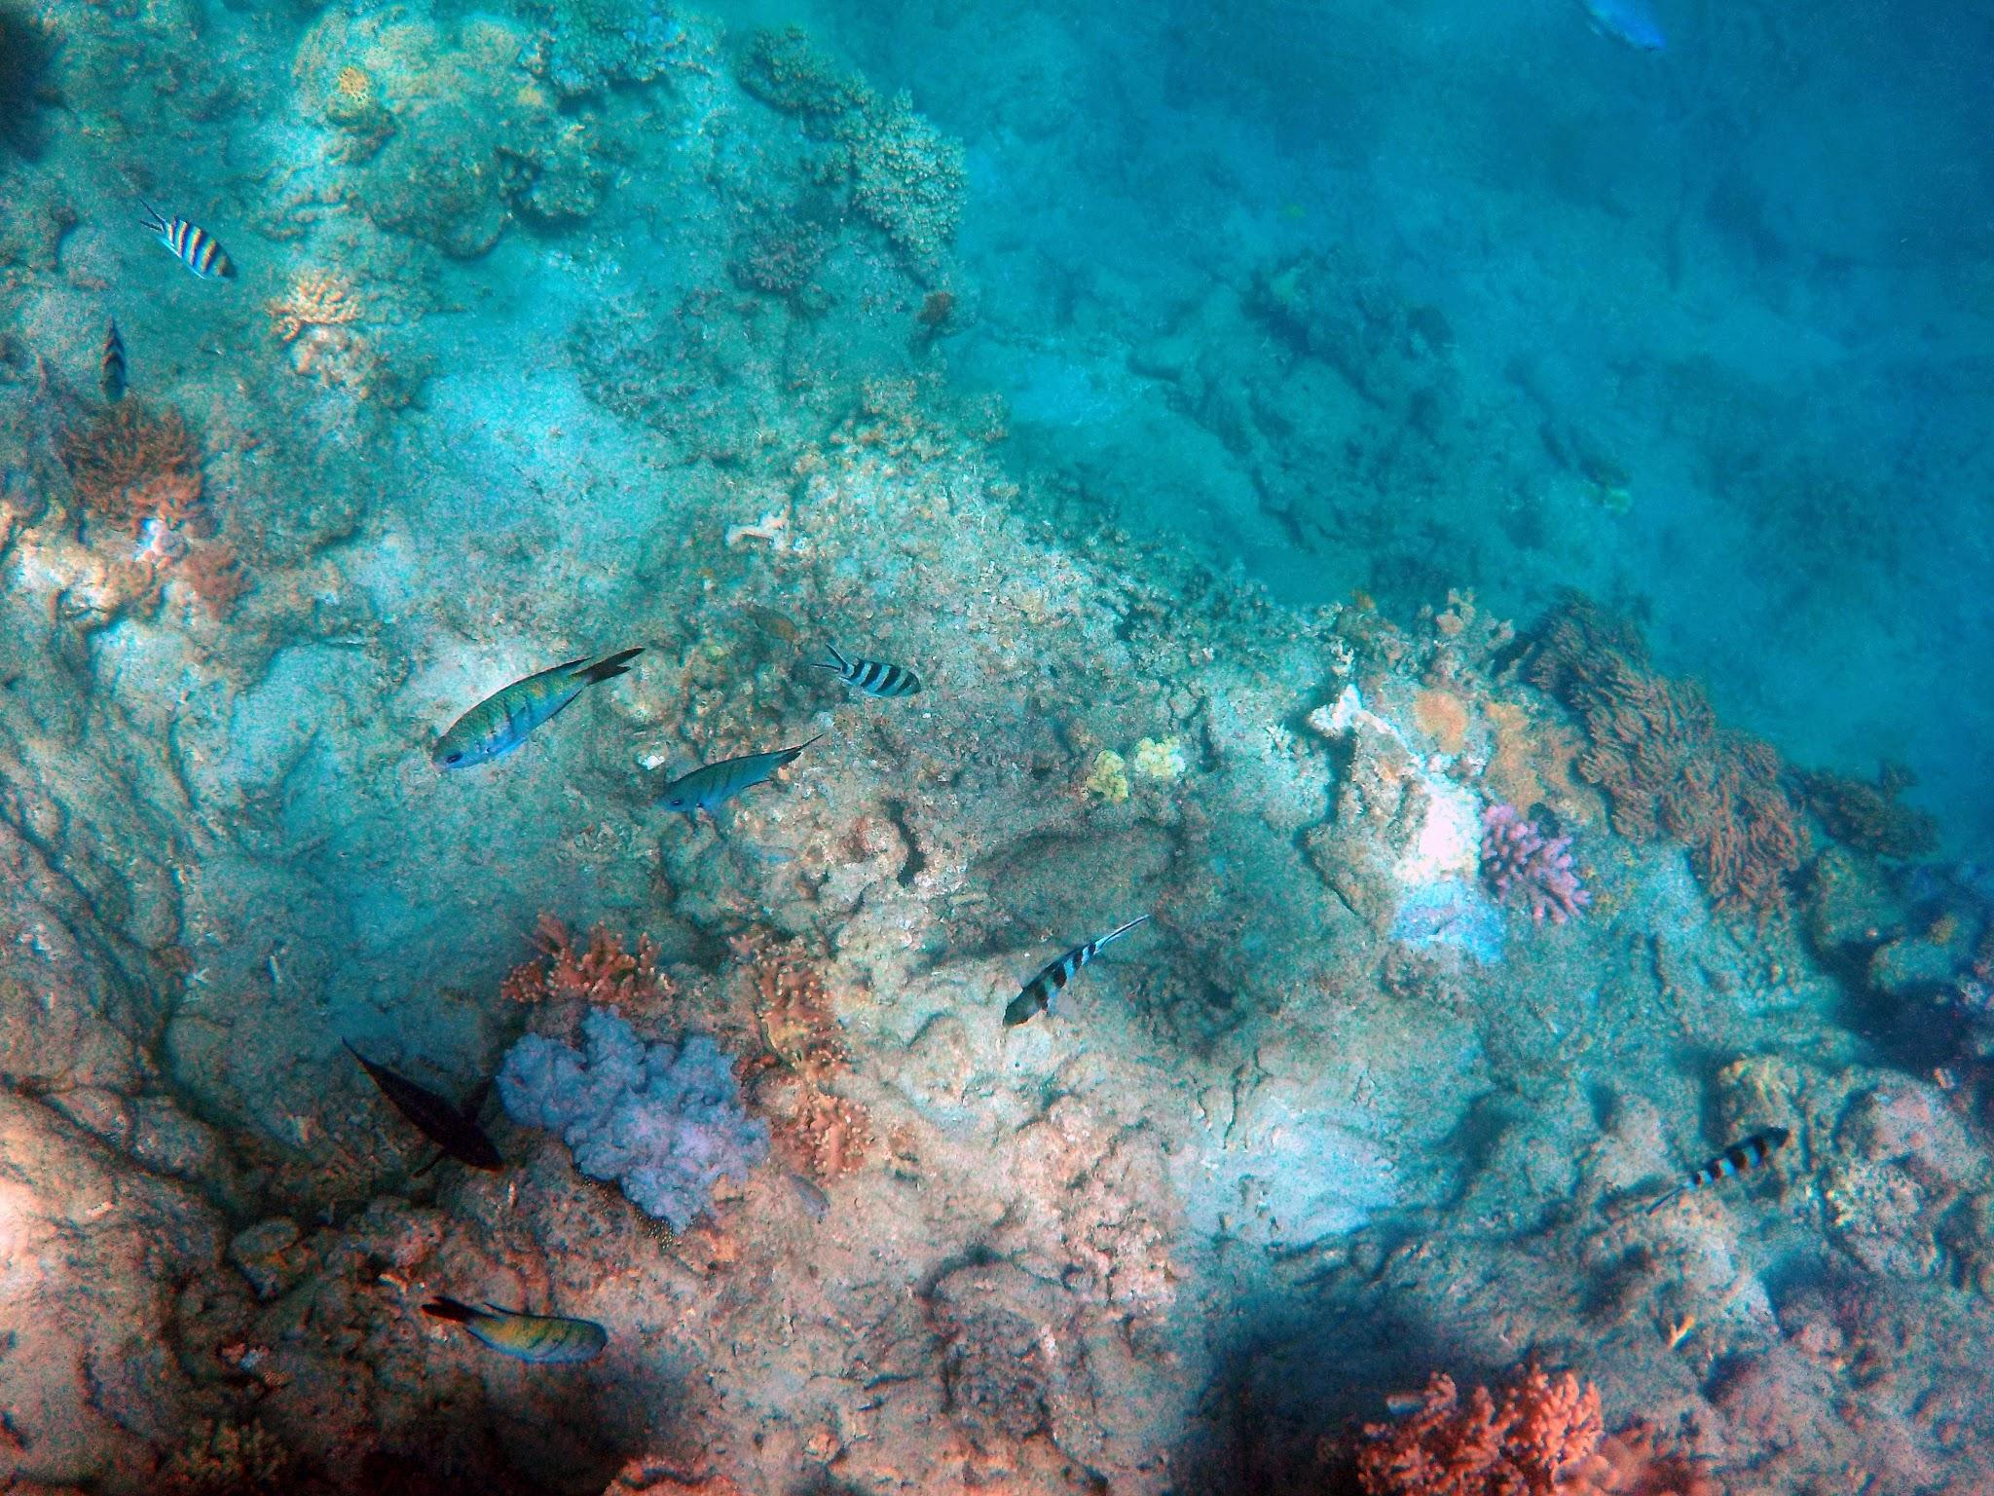
Underwater Image Enhancement
Intern Name: Raihan Kabir Choudhury
Internship Location: IITG

Slide 2
Outline
Introduction
Project Overview
Understanding Underwater Imagery
Image Enhancement
Degradation Effects
FUnIE-GAN
Project Objectives
Data Collection
Simulating Underwater Conditions
Degraded Results
Model Testing
Evaluation and Comparison
Enhanced Results
Workflow
Conclusion and Insights
Future Directions
This presentation will cover the following key topics:

Slide 3
Introduction
This presentation introduces the Underwater Image Enhancement, a comprehensive exploration of techniques aimed at enhancing the visual quality of images captured in underwater environments. This project addresses the unique challenges associated with underwater imagery and the strategies employed to improve its clarity and information content.

Slide 4
Project
Overview
This project aimed to improve the quality of underwater images, which often suffer from degradation due to various factors. The primary objectives included data collection, simulating underwater conditions, model testing, and performance evaluation.

Slide 5
Underwater Imagery
Understanding Underwater Imagery
Underwater imagery refers to images captured in aquatic environments, such as oceans, rivers, or lakes. The challenges in underwater photography are attributed to water turbidity, limited visibility, and color absorption.

Slide 6
Image Enhancement
Image enhancement is the process of improving the visual quality of an image, making it more suitable for human perception or machine analysis. In the context of underwater images, this process is essential to reveal hidden details.

Slide 7
Degradation Effects
In the context of underwater images, degradation effects are factors that degrade image quality. These effects can include:
Illumination
Low Contrast
Color Cast
Noisy
Blurred
Foggy
Desaturated

Slide 8
FUnIE-GAN
FUnIE-GAN is an image enhancement model that leverages Generative Adversarial Networks (GANs) to improve the quality of underwater images. It integrates multiple GANs to enhance image clarity, reduce noise, and enhance colors in underwater imagery. It is a pre-trained adversarial model, trained on both paired and unpaired data from EUVP dataset.
Fast Underwater Image Enhancement - Generative Adversarial Networks

Slide 9
Project Objectives
The project had four main objectives:
Data Collection
Simulating Underwater Conditions
Model Testing
Evaluation and Comparison

Slide 10
Data Collection
Frames were extracted from underwater videos that are accessible online to create an initial dataset for the project. This involved extracting frames at a rate of 30 frames per second (fps) using FFmpeg (a open source multimedia framework), resulting in a substantial dataset of original images.

Slide 11
Simulating Underwater Conditions
Various underwater degradation effects were applied to the original images. These effects included adjustments to illumination, contrast, color cast, noise, blurriness, fog, and desaturation. The degraded images were organized into subfolders under the 'Degraded' directory.

Slide 12
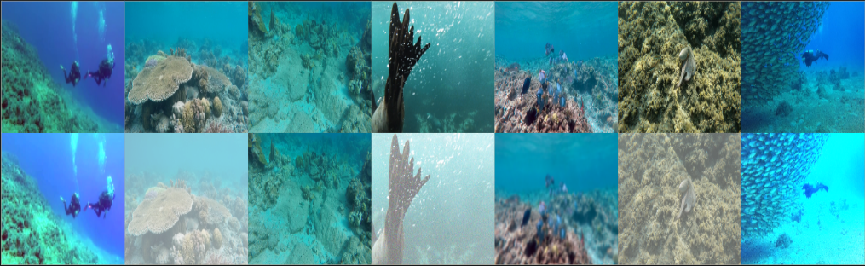
Degraded Results
Original Images:
Illumination
Low Contrast
Color Cast
Noisy
Blurred
Foggy
Desaturated

Slide 13
Model Testing
For image enhancement and evaluation, a pre-trained image enhancement model called FUnIE-GAN was utilized. The model was loaded from a saved checkpoint, which included both the model architecture and weights. The model's primary objective was to enhance the quality of the degraded underwater images, effectively reducing the impact of degradation effects.

Slide 14
Image Enhancement and Evaluation
This code performs image enhancement and evaluation using FUnIE-GAN on multiple datasets, including "EUVP," "UIEB," and a custom "Degraded" dataset.
It involves the following steps:
Randomly selects a subset of 890 images from the specified datasets for testing.
Utilizes a pre-trained FUnIE-GAN model for image enhancement.
Measures the Mean Squared Error (MSE) and Peak Signal-to-Noise Ratio (PSNR) to evaluate image quality.
Generates and saves side-by-side comparisons of original and enhanced images.
These results demonstrate the model's effectiveness in improving image quality.

Slide 15
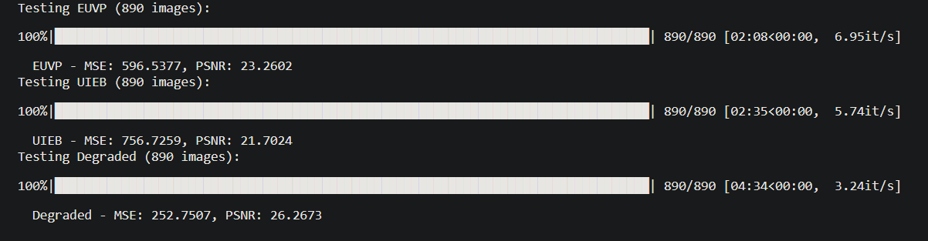
Evaluation and Comparison
The evaluation process involved assessing the quality of the enhanced images on all three datasets using two key metrics: Mean Squared Error (MSE) and Peak Signal-to-Noise Ratio (PSNR).

Slide 16
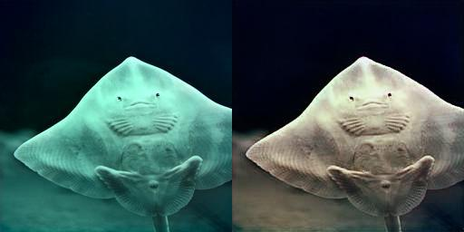
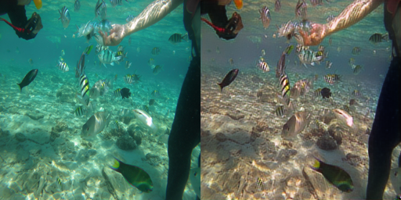
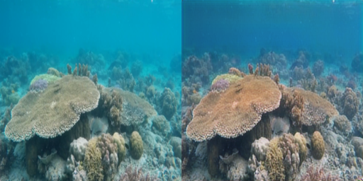
Enhanced Results
Displaying enhanced images from "EUVP," "UIEB," and "Degraded" datasets, showcasing the effectiveness of FUnIE-GAN in improving image quality.
EUVP
UIEB
DEGRADED

Slide 17
Workflow
Data Collection
Data Enhancement
Model Testing
Results Analysis

Slide 18
Conclusion and Insights
The project yielded valuable insights into underwater image enhancement and the effectiveness of the FUnIE-GAN model. Key takeaways included the significance of custom datasets and the superior performance of FUnIE-GAN in mitigating underwater degradation effects.

Slide 19
Future Directions
The project opens up numerous opportunities for future research and development in the field of underwater image enhancement. Possible directions include exploring additional degradation effects, investigating alternative enhancement models, and real-world testing of enhancement solutions

Slide 20
References
D. Akkaynak and T. Treibitz. A Revised Underwater Image Formation Model. In IEEE Conference on Computer Vision and Pattern Recognition (CVPR), , 2018.
M. Arjovsky, S. Chintala, and L. Bottou. Wasserstein Generative Adversarial Networks. In International Conference on Machine Learning (ICML), 2017.
M. J. Islam, Y. Xia and J. Sattar, "Fast Underwater Image Enhancement for Improved Visual Perception," in IEEE Robotics and Automation Letters, 2020.
M. Bryson, M. Johnson-Roberson, O. Pizarro, and S. B.Williams. True Color Correction of Autonomous Underwater Vehicle Imagery. Journal of Field Robotics (JFR), 2016
B. Cai, X. Xu, K. Jia, C. Qing, and D. Tao. DehazeNet: An End-to-end System for Single Image Haze Removal. IEEE Transactions on Image Processing, 2016

Slide 21
Thank You!

